Slide 1

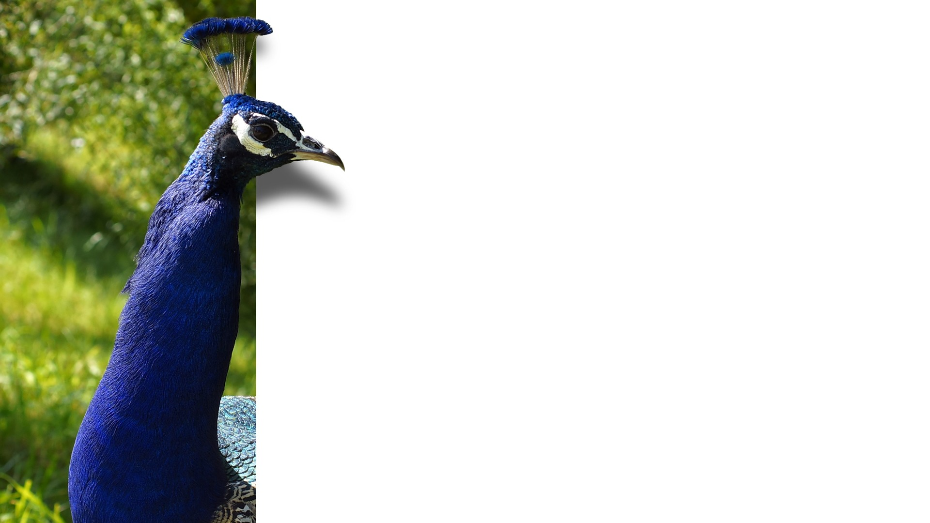
TriAD: A Distributed Shared-Nothing RDF Engine
based on Asynchronous Message Passing
Sairam Gurajada Stephan Seufert Iris Miliaraki
Max-Planck Institute for Informatics
Martin Theobald
University of Antwerp
SIGMOD‘14’
Presented by Wu Yilun
Notes:
马克思-普朗克计算机科学研究所 德国
安特卫普大学 比利时

Slide 2
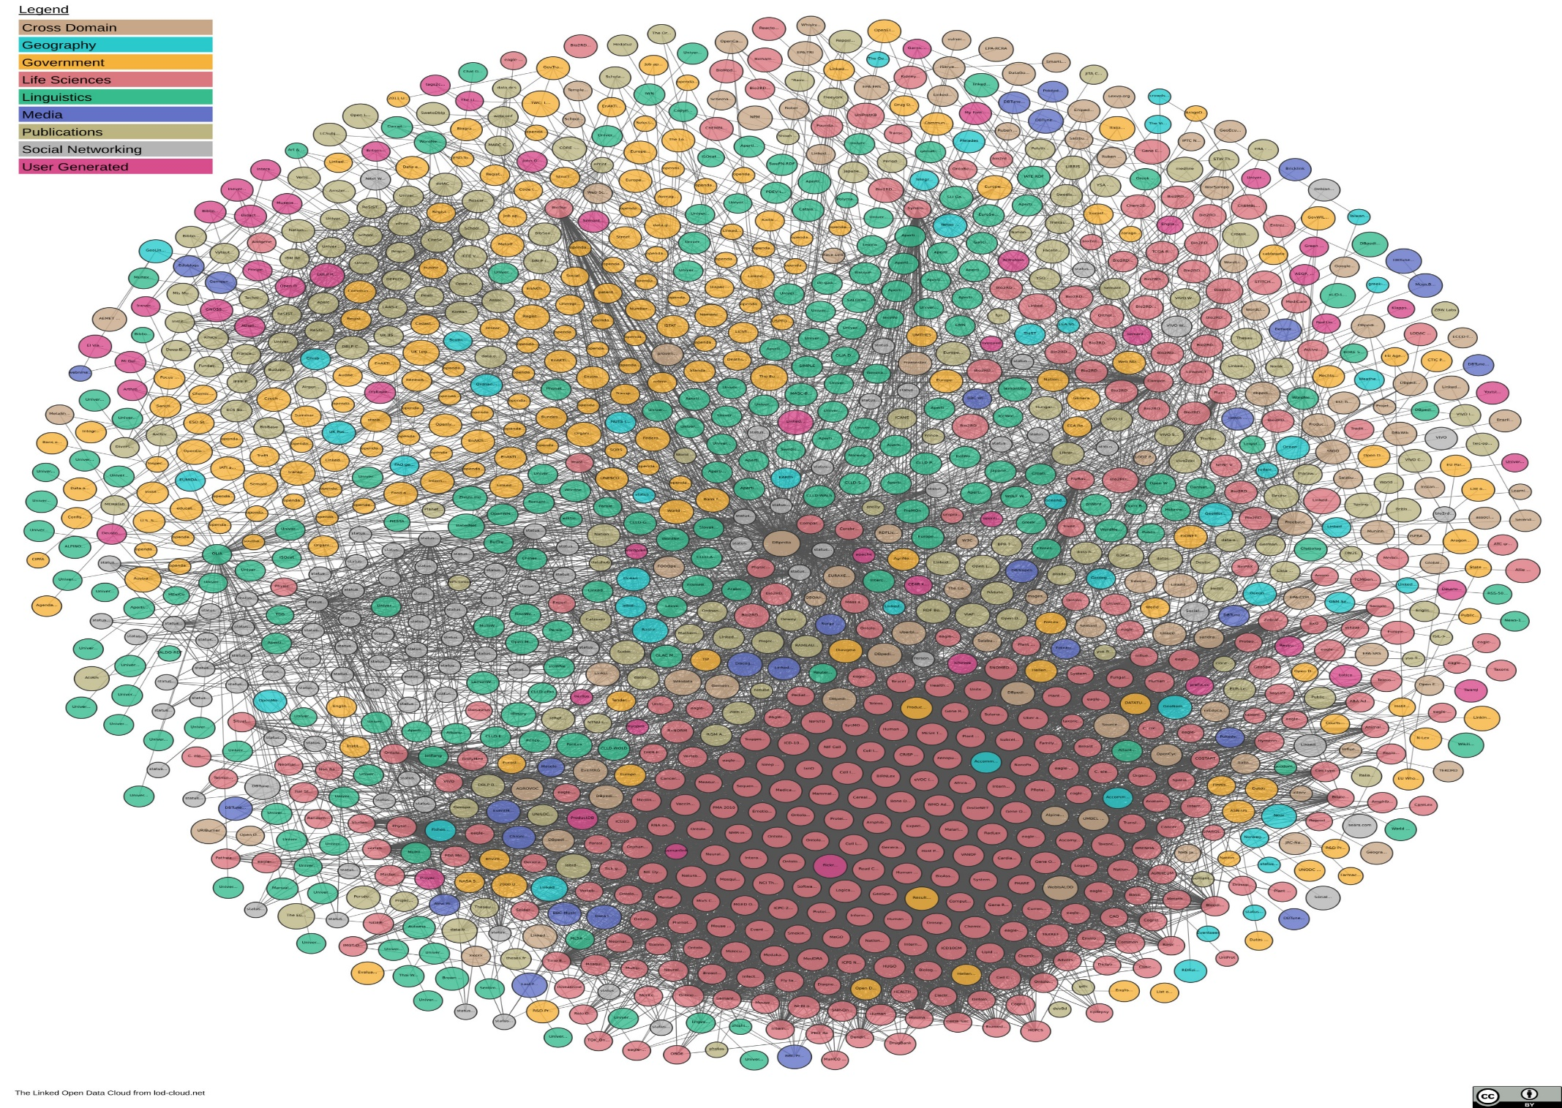
Credited by https://lod-cloud.net/

Slide 3
RDF&SPARQL
Resource Description Framework
Subject
Predicate
Object
SPARQL Protocol and RDF Query Language

Slide 4
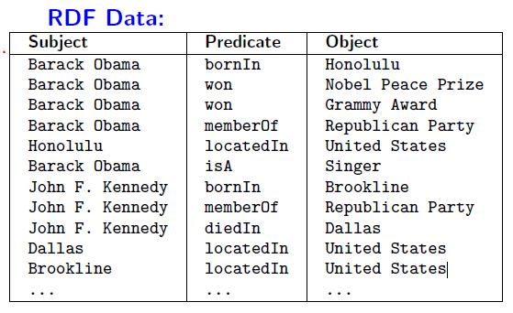
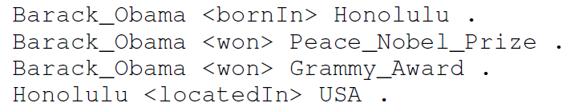
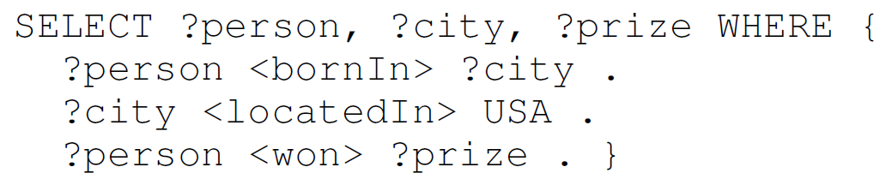
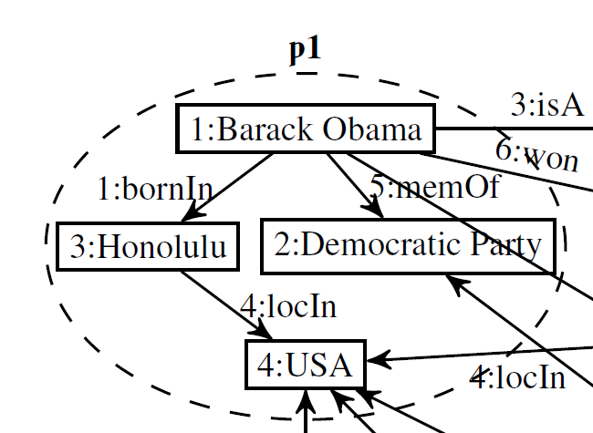
RDF&SPARQL

Slide 5
Current Approaches
Relational-based
crucial factors – Join-order optimization, Join-ahead pruning, indexing layout, choice of operators
Eg. Jena, Sesame, HexaStore, SW-Store, RDF-3X, ...
Graph-based
Trinity.RDF
Problems with existing distributed relational-based RDF engines
1. Synchronous processing of joins
2. Dangling triples – occur in intermediate relations but not in final results
Notes:
Trinity.RDF和TriAD

Slide 6
TriAD Architecture
TriAD (for “Triple Asynchronous and Distributed”)
– a distributed RDF Store

Slide 7
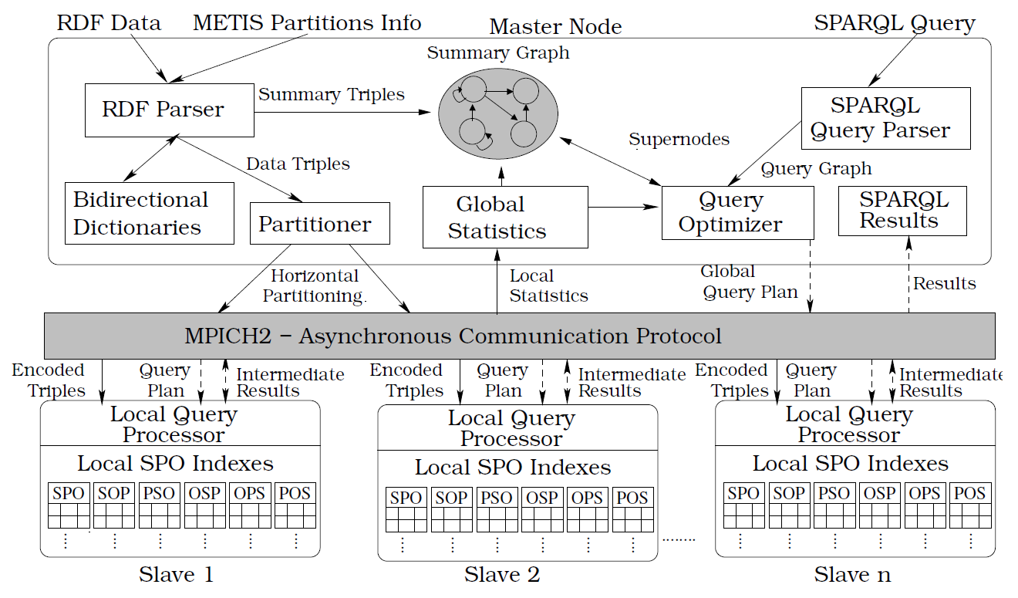
TriAD Architecture
Index

Slide 8
TriAD Architecture
Query Stage 1
Query Stage 2

Slide 9
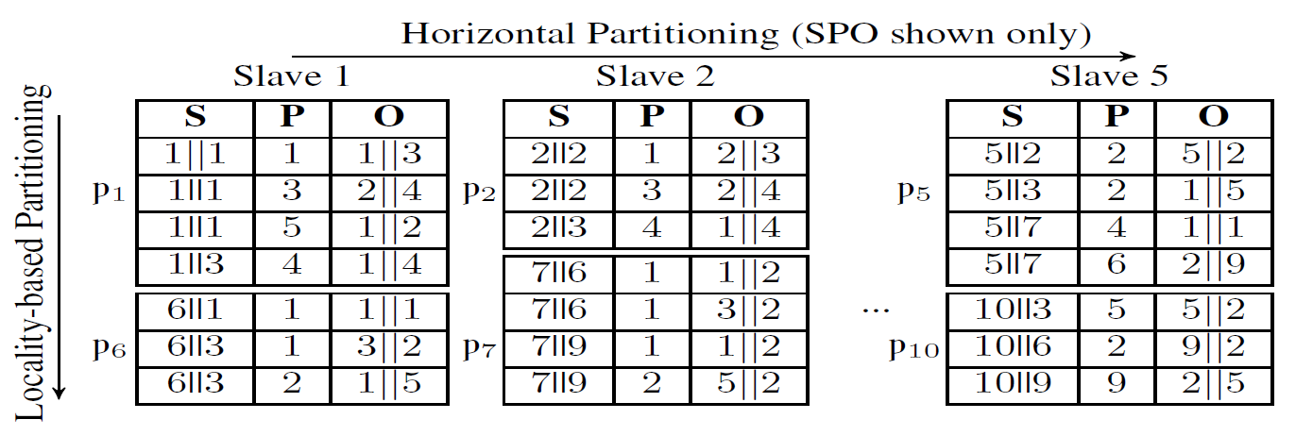
Index
(BarackObama, won, NobelPrize)
Data triple: (1||1, 6, 4||3)
Summary triple: (1, 6, 4)

Slide 10
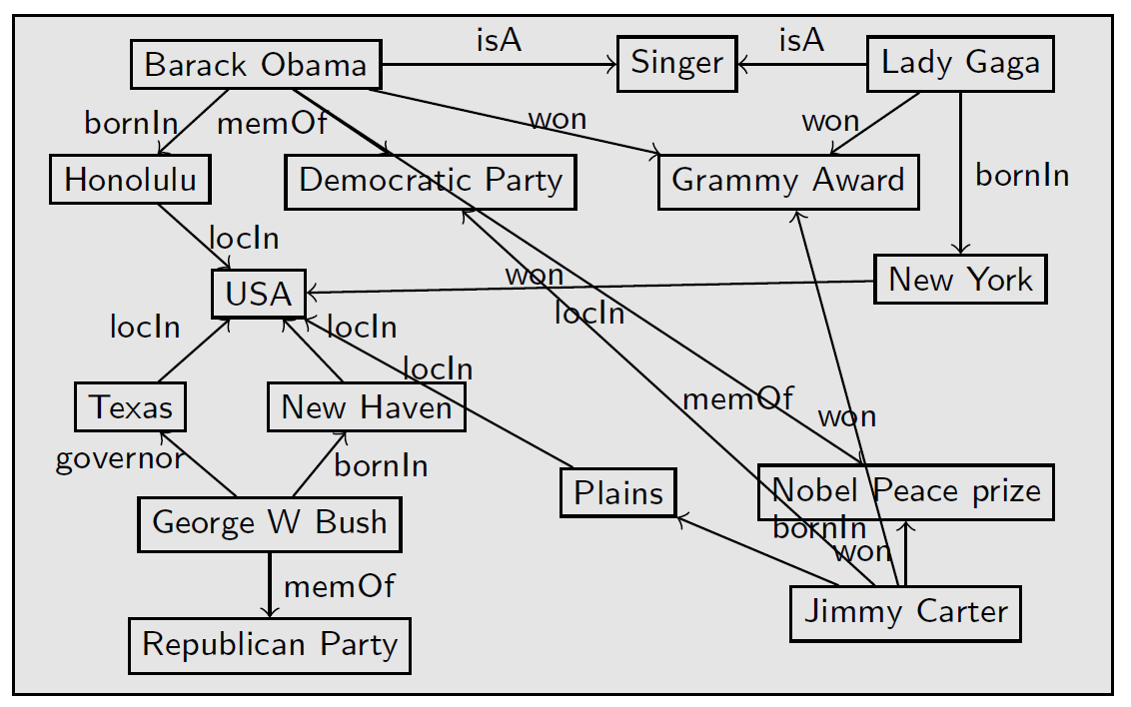
Join-ahead Pruning via Graph Summarization

Slide 11
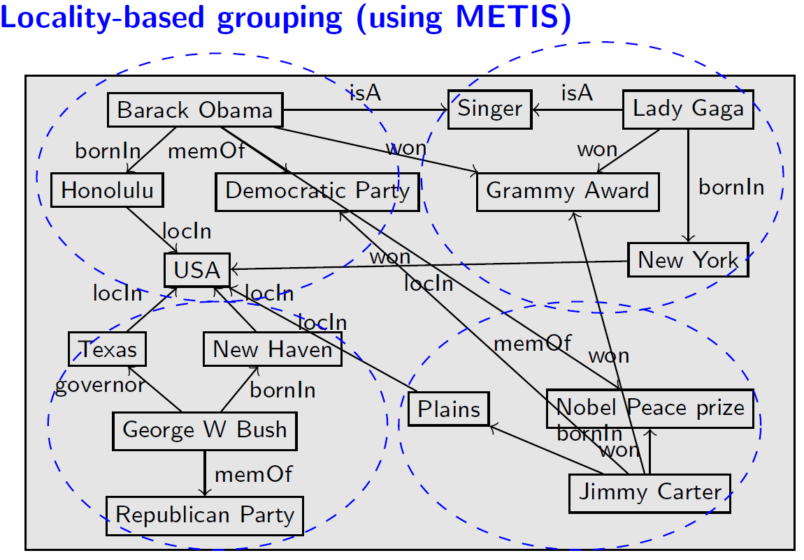
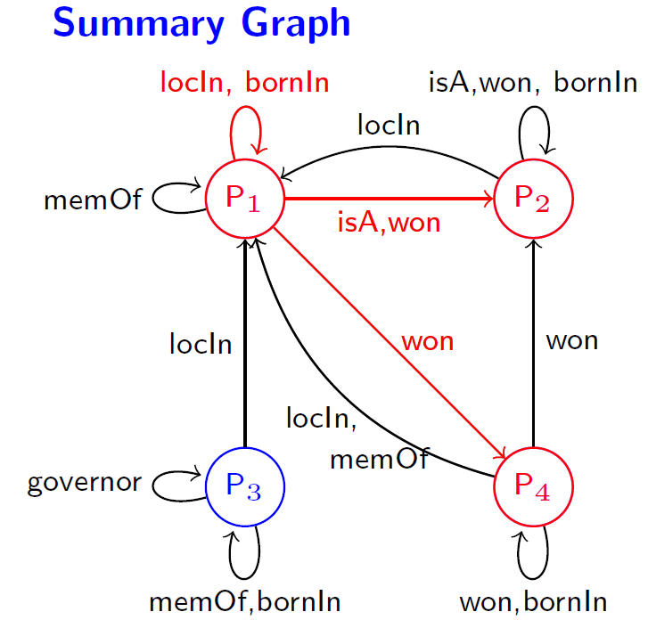
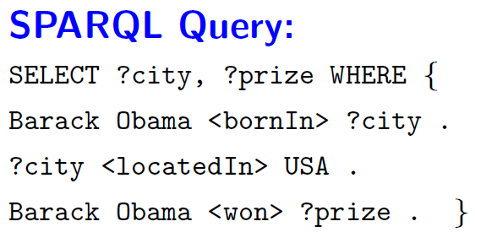
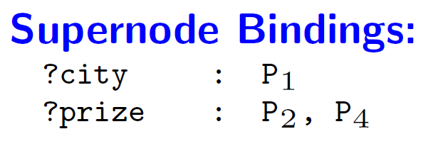
Join-ahead Pruning via Graph Summarization

Slide 12
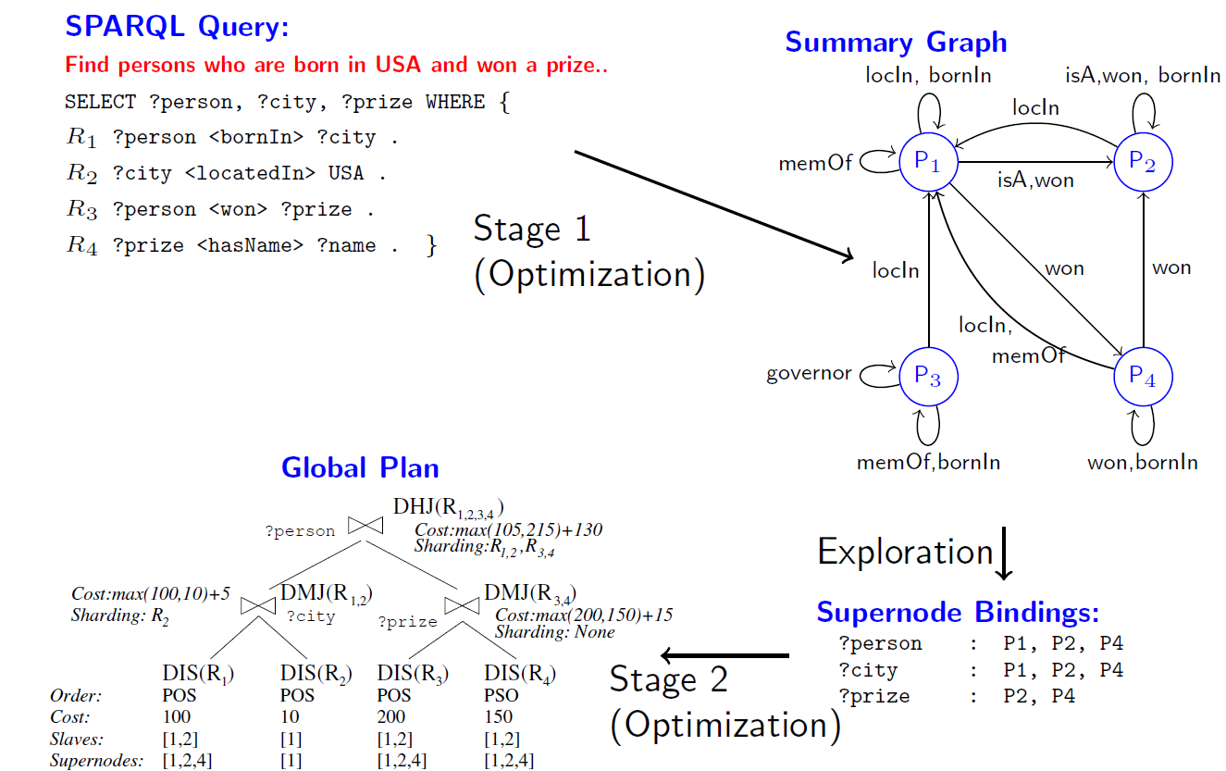
Querying Optimization & Processing - Example

Slide 13
Experiments
Compared with the following state-of-art systems
Centralized systems – RDF-3X, MonetDB-RDF, BitMat
Distributed systems – H-RDF-3X, Trinity.RDF, 4store, SHARD, Spark
Benchmark:
(Synthetic) LUBM 160 – 28 Million triples, 16GB raw data
(Synthetic) LUBM 10240 – 1.8 Billion triples, 730GB raw data
(Real world) BTC 2012 – 1.4 Billion triples, 231 GB raw data
(Synthetic) WSDTS – 109 Million triples, 15 GB raw data

Slide 14
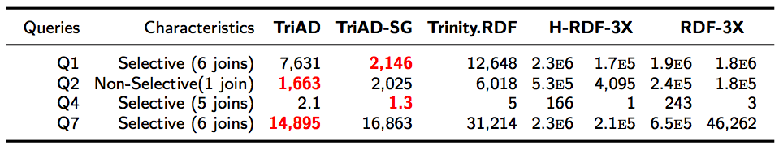
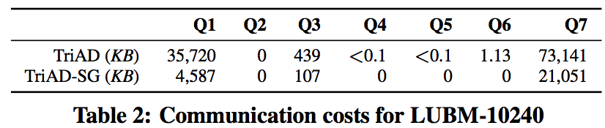
Experiments
Latency
Summary graph

Slide 15
Summary
TriAD is a fast distributed RDF engine built on top of asynchronous communication layer and multi-threaded execution framework
efficient distributed and parallel join executions
join-ahead pruning technique via graph summarization helps in pruning dangling triples and making query processing efficient
distributed- and join-ahead pruning aware query optimizer
so far reported fastest runtimes over three benchmark datasets: LUBM, BTC,WSDTS

Slide 16

Thanks for your attention

Slide 17
Backup Slides
x1
y1
z1
x1
y1
z1
x1
y1
z2
x2
y2
z2
x1
y2
z1
x3
y3
z3
x1
y2
z2
x4
x1
y2
z3
x1
y3
z1

